Slide 1
Chemical bonding
3.1 Electronegativity and bonding
3.2 Ionic bonding
3.3 Metallic bonding
3.4 Covalent bonding and coordinate (dative covalent) bonding
3.5 Shapes of molecules
3.6 Intermolecular forces, electronegativity and bond properties
3.7 Dot and cross diagrams

Slide 2
Introduction
Atoms are held together in compounds by chemical bonds.
Ionic bonding is due to the electrostatic attraction between positive and negative ion.
Covalent bonding is due to electron sharing between the atoms of a molecule. Ionic crystals are in a lattice structure.
In this topic, ionic bonding, covalent bonding, shapes of molecules, electronegativity and intermolecular forces are explained in detail.

Slide 3
Ionic bonding
Ions are formed when atoms lose or gain electrons.
Metals lose electrons from its outermost shell to form positive ions.
Non-metals gain electrons to form negative ions.
The electrostatic charge on the ion depends on the number of electrons gained or lost.
When metals and non-metals combine, the electrons in the outermost shell of metal are transferred to the non-metal and both enter a stable configuration (of noble gases).

Slide 4
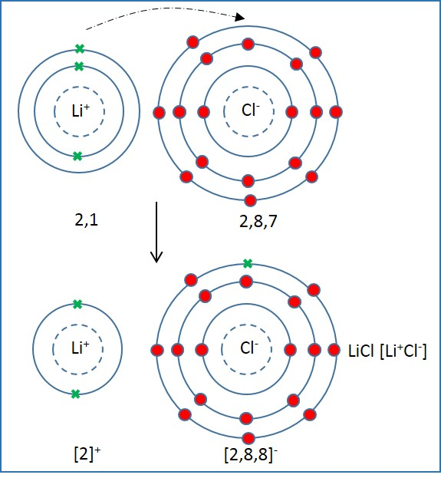
Ionic bonding
Electron configuration of Li (Atomic number=3): 2, 1
Electron configuration of Cl (Atomic number=17): 2, 8, 7
Lithium loses one electron in its outermost shell and Chlorine gains one electron to form a stable configuration.
Electron configuration of Li⁺: 2
Electron configuration of Cl⁻: 2, 8, 8
The ions in ionic compounds are arranged in a regular pattern called lattice structure.
The electrostatic force of attraction between positive and negative ions holds the atoms together and thus form crystals.
This force of attraction is very strong and hence, ionic bonds are strong.

Slide 5
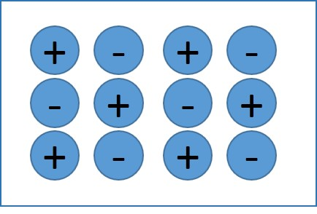
Ionic Crystals
Ionic bonding is the strong electrostatic force of attraction between oppositely charged ions in a lattice structure as shown in figure.
The strength of metallic bonding depends on:
Size of ions
Charge of ions
Smaller ions have stronger ionic bonding. For example: KCl has a low melting point than NaCl, as the ionic radius of Potassium ion is larger than that of Sodium ion. Hence, KCl is larger in size than NaCl. Thus, it has weaker ionic bonding, and less melting point than NaCl.
Giant ionic lattice

Slide 6
Ionic Crystals
Charge of ions
Higher the charge of the ions, stronger will the force of attraction and hence, stronger the ionic bonding. The ionic bond of MgO is stronger than NaCl because Mg²⁺ and O²⁻ are larger in charge when compared to Na⁺ and Cl⁻. As a result, the melting points of MgO is higher than that of NaCl.
Giant ionic lattice

Slide 7
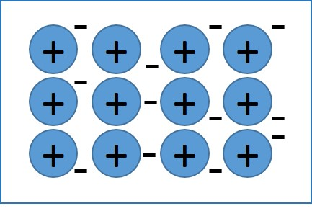
Strength of metallic bonding
Metals are bonded in giant lattice structure held together strong electrostatic force of attraction between positive ions and free electrons.
The strength of metallic bonding depends on:
    Number of protons: The more the protons, stronger the force of attraction and stronger is the bond.
    Number of free electrons : The more the number of free electrons, the stronger the bond.
    Size of ion: The smaller the ion, the stronger the bond.

Slide 8
Strength of metallic bonding
When potential difference is applied to both the ends of the metals, the free electrons move away from the negative terminal due to repulsion.
Electrical conductivity increases with number of free electrons.
Sodium, magnesium and aluminium have one, two and three free electrons respectively. Hence, the electrical conductivity increases from sodium to aluminium.
The electrical conductivities of period 3 elements are:
Element | Na | Mg | Al | Si | P | S | Cl | Ar
Relative Electrical conductivity (Al=1) | 0.55 | 0.61 | 1.00 | 0.10 | 0 | 0 | 0 | 0

Slide 9
Melting point and boiling point
The melting point and boiling point increases from Na to Si due to increase in strength of metallic bonding.
The strong force of attraction between metal ion and delocalised electrons requires high energy to break. The melting point increases with the increase in number of charges.
The melting points of elements in period 3 are:
Element | Na | Mg | Al | Si | P | S | Cl | Ar
Melting point (K) | 371 | 923 | 932 | 1683 | 317 | 392 | 172 | 84

Slide 10
Covalent bonding
Covalent bonds are formed when non-metals combine to form compounds.
In covalent bonds, two or more atoms are held together by the force of attraction between nuclei of atoms (positively charged) and one or more pair of shared electrons (negatively charged).

Slide 11
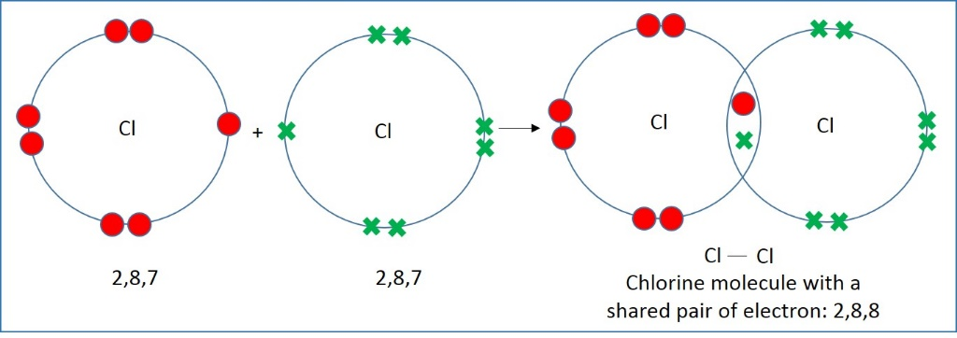
Single covalent bonding
Covalent bonds with a pair of shared electrons is called as single covalent bonding.
Chlorine is a non-metal with 7 electrons in its outermost shell. It needs one more electron to reach the stable configuration.
Hence, two chlorine atoms combine to form a molecule where two electrons are shared.

Slide 12
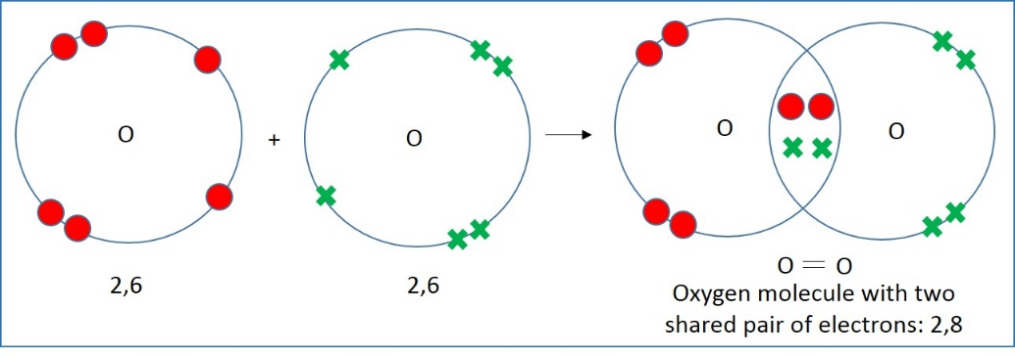
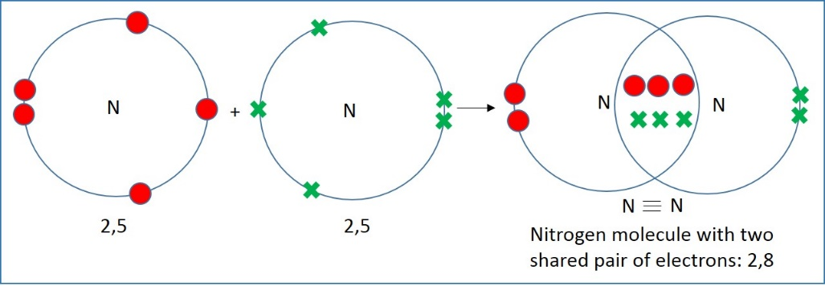
Multiple covalent bonding
Some atoms share two pair of electrons during the formation of covalent bonds, such type of bonds are called as double covalent bonds.
For example: oxygen has 6 electrons in its outermost shell and needs two more to reach the stable configuration.
Hence, two oxygen atoms combine to form oxygen molecule where two pair of electrons are shared.
The outer pair of electrons that are not used in bonding are called as lone pair of electrons.
Some atoms combine to form molecules with three pair of shared electrons called as triple covalent bonds. For example: nitrogen has 5 electrons in its outermost shell and needs three more to reach the stable configuration. Hence, two nitrogen atoms combine to form nitrogen molecule where three pair of electrons are shared.
Double covalent bonding
Triple covalent bonding

Slide 13
Dative covalent bonding
Dative covalent bonding is formed when one atom provides the shared pair of electrons in a molecule.
There are two conditions for the dative covalent bond to be formed:
An atom with a lone pair of electron.
Another atom that is electron-deficient that is, with an empty orbital to accept the lone pair of electron

Slide 14
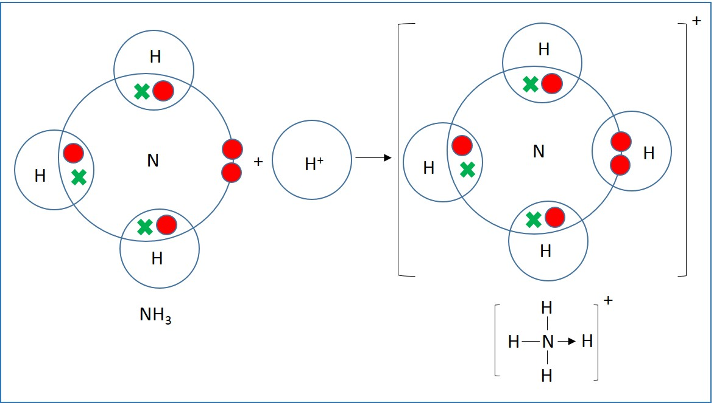
Dative covalent bonding
Ammonium ion NH₄⁺ is formed when ammonia NH₃ combines with hydrogen ion H⁺.
The hydrogen ion is electron-deficient. Ammonia has a lone pair of electron that is shared by ammonia and hydrogen to form a dative covalent bond.
The arrow mark in ammonium ion represents the sharing of lone pair of electrons. The head always points away from the lone pair that forms the bond.
Dative covalent bonding

Slide 15
Bond energy
Generally, double bonds are shorter and stronger than single bonds because the force of attraction between the nucleus and electrons is higher in cases of double bonds.
Bond energies determine the reactivity of an element.
Double-bonded carbon atoms are harder to break when compared to single bonded carbon atoms.
Nitrogen is unreactive as it requires
945 kJ/mol to break the bond.
Bond | Bond energy (kJ/mol) | Bond length (nm)
C-C | 350 | 0.154
C=C | 610 | 0.134
C-O | 360 | 0.143
C=O | 740 | 0.116
NΞN | 945 | 0.11
Bond energies

Slide 16
Electronegativity and bond polarity
Electro-negatively is the property of a particular atom bonded covalently, to attract the bonding pair of electrons towards itself. The pattern of electronegativity from group 1 to 17 are:
Increases across the period from left to right
Increases up each group
Using above conditions, fluorine is the most electronegative element.
If atoms in a molecule have equal electronegativity, the pair of electrons are shared equally, and these bonds are called as non-polar bonds. For example: O₂, N₂, Cl₂, etc

Slide 17
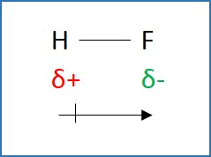
Electronegativity and bond polarity
When the bond is formed between two atoms of different electronegativity, the shared pair of electrons are attracted towards the more electronegative atom and hence, these bonds are called as polar or dipole.
The electron distribution in this type of molecules is asymmetric.
The covalent bond between Hydrogen and fluorine in HF is polar.
The shared pair of electrons is attracted more towards fluorine because of its higher electronegative value.
Fluorine gets a slight negative charge.
The direction of dipole generally points the partially negatively charged.

Slide 18
Electronegativity and bond polarity
Electronegativity values are measured using Pauling scale (1 to 4). Elements of similar electronegativity values form purely covalent bonds and when the difference of electronegativity between two elements is more than 1.7, the elements form ionic bonds.
When the difference of electronegativity values is between 0.3 and 1.7, the elements form polar covalent bonds. For example: HF.

Slide 19
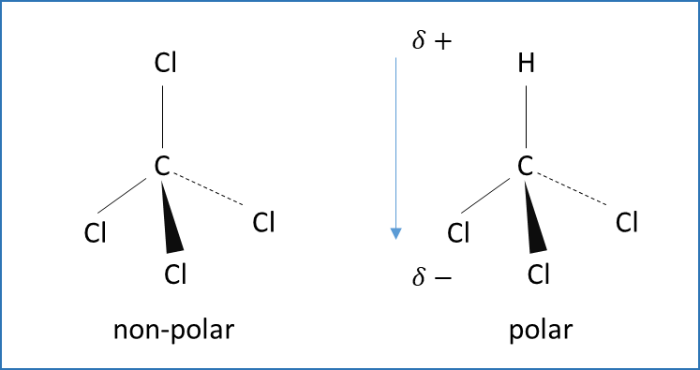
Electronegativity and bond polarity
The shape of the molecules also affects the polarity.
Symmetric molecules such as carbon dioxide cannot be polar because the individual dipoles cancel out.
CCl₄ with a tetrahedral structure is another example of non-polar molecule.
CHCl₃ with a tetrahedral structure is an example of polar molecule. The dipoles do not cancel out in CHCl₃.

Slide 20
Shape of simple molecules and ions
The shape and bond angles of a covalently bonded molecule depends on the number of pairs around each atom and the nature of the pairs such as lone pairs or bonding pairs.
The force of repulsion depends on the nature of the pair of electrons. The order of forces of repulsion is:
lone pair-lone pair> lone pair-bond pair> bond-pair-bond pair.

Slide 21
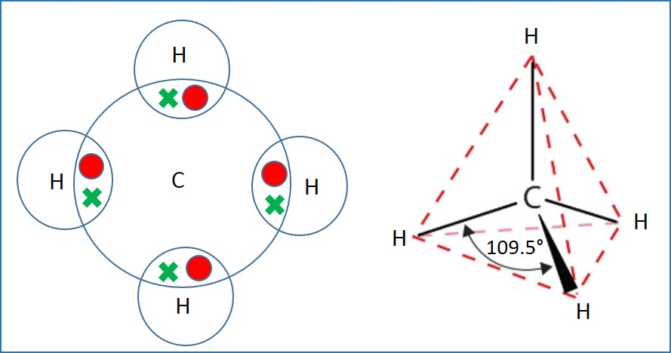
Shape of methane molecule
In methane, the forces of repulsions are equal for the four pair of electrons.
Hence, the shape of the molecule is tetrahedron with H-C-H bond angle of 109.5⁰.
Structure of methane

Slide 22
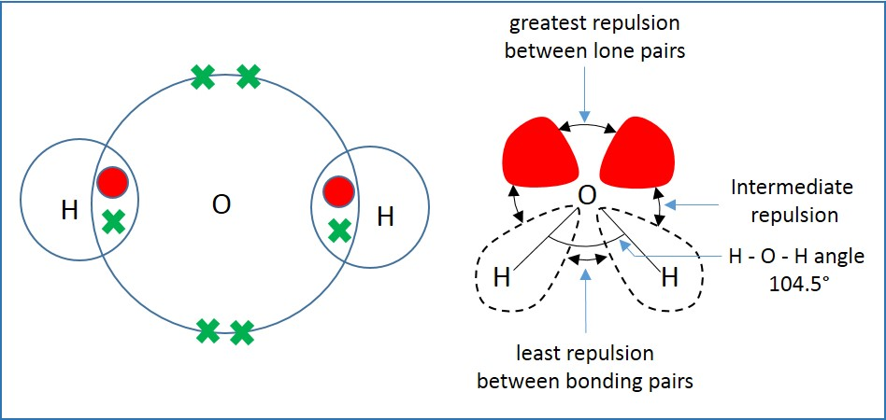
Shape of water molecule
In water, the forces of repulsion are not equal between the four pair of electrons and hence, the tetrahedral shape as in methane is distorted.
In water the bond pairs are pushed much closer because of two lone pair of electrons and forms a linear V-shape with H-O-H angle of 104.5⁰.
Structure of water molecule

Slide 23
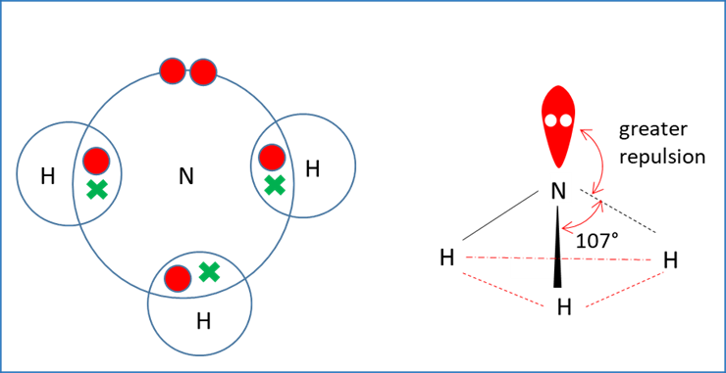
Shape of ammonia molecule
Ammonia has a triangular pyramidal shape.
In ammonia, the forces of repulsion are not equal between the four pair of electrons and hence, the tetrahedral shape as in methane is distorted.
The lone pair-bond pair repulsion is greater than the bond pair-bond pair repulsion and hence, the bonding pairs come closer together making H-N-H bond angle of 107⁰.
Structure of ammonia

Slide 24
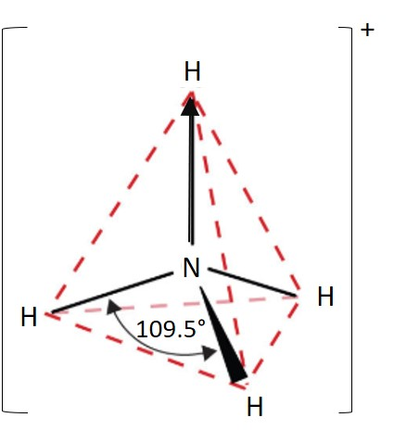
Shape of ammonium ion
In ammonium ion, NH₄⁺, the dative bond acts as a covalent bond and the shape is tetrahedral.
Four bonding pair of electrons repel equally to from a tetrahedral shape that minimises the repulsions.
Structure of ammonium ion

Slide 25
Shape of Al₂Cl₆
AlCl₃ is an electron deficient molecule. At high temperatures, it exists in this molecular form.
At lower temperatures, two AlCl₃ molecules combine to form, Al₂Cl₆.
Two lone pair of electrons on two chlorine atoms, forms co-ordinate dative bonds with aluminium.

Slide 26
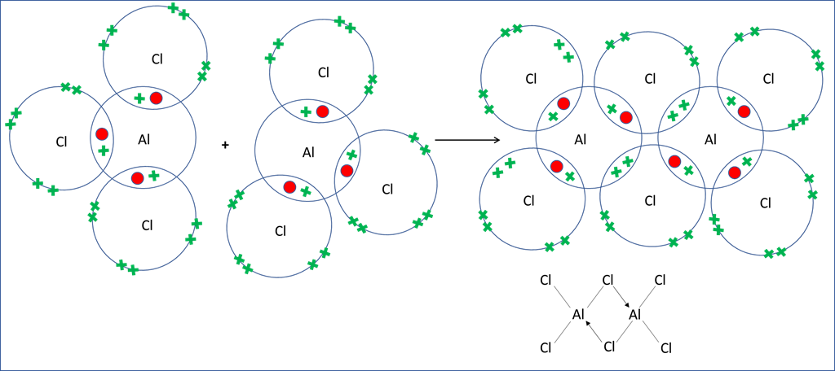
Shape of Al₂Cl₆

Slide 27
Shape of molecules
Shape | Num. of bonding pairs | Num. of lone pairs | Examples
Linear | 2 | 0 | BeF₂
 | 2 | 3 | XeF₂
Trigonal planar | 3 | 0 | BF₃
Tetrahedral | 4 | 0 | CH₄
Pyramidal | 3 | 1 | NH₃
Bent | 2 | 2 | H₂O
Trigonal bipyramidal | 5 | 0 | PF₅
Square-based pyramidal | 5 | 1 | ClF₅
Octahedral | 6 | 0 | SF₆
T-shaped | 3 | 2 | ClF₃
Square planar | 4 | 2 | XeF₄

Slide 28
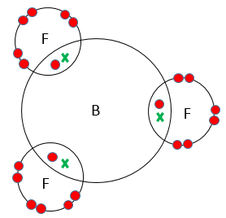

Shape of simple molecules and ions
Molecular formula | Electron structure | Shape | Bond angle
BF₃ Boron trifluoride |  | Trigonal planar | 120⁰ (F-B-F )

Slide 29
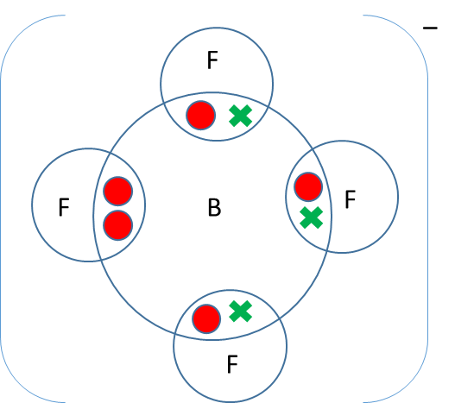
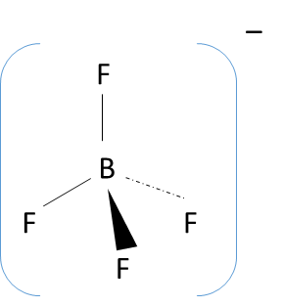
Shape of simple molecules and ions
Molecular formula | Electron structure | Shape | Bond angle | Examples
BF₄⁻ Boron trifluoride |  | Tetrahedral | 120⁰ (F-B-F ) | CH₄, NH₄⁺

Slide 30
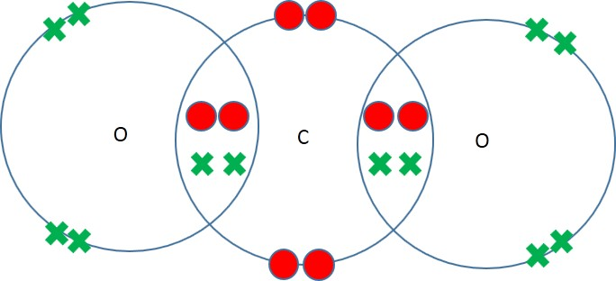
Shape of simple molecules and ions
Molecular formula | Electron structure | Shape | Bond angle | Example
CO₂ Carbon dioxide |  | Linear O=C=O | 180⁰ (O=C=O) | BeCl₂

Slide 31
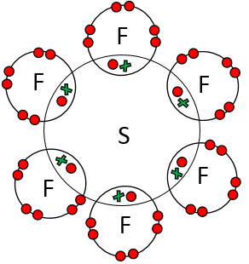
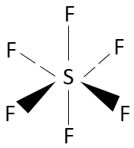
Shape of simple molecules and ions
Molecular formula | Electron structure | Shape | Bond angle
SF₆ Sulphur hexafluoride |  | octahedral | 90⁰ (F-S-F)

Slide 32
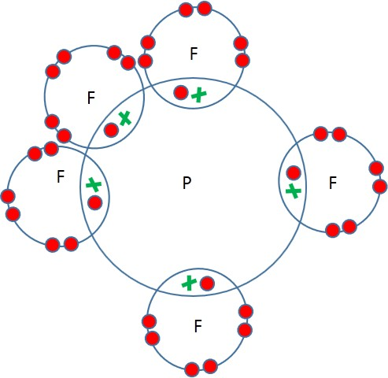
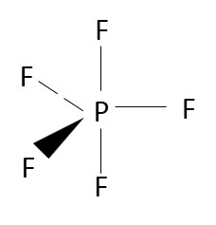
Shape of simple molecules and ions
Molecular formula | Electron structure | Shape | Bond angle
PF₅ Phosphorous pentafluoride |  | Trigonal bipyramidal | 120⁰ and 90⁰

Slide 33
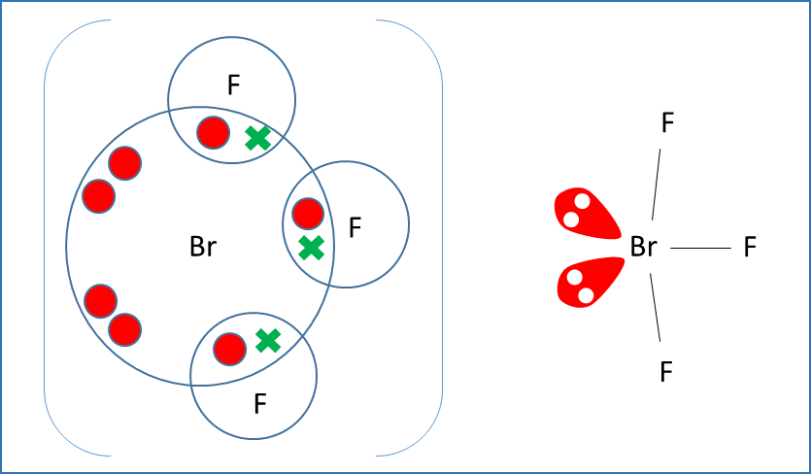
More shapes
Consider the molecule BrF₃, the outermost configuration in Br is 4s²4p⁵. It requires an electron to reach stable state.
As a result, BrF₅ has 3 bonding pair of electrons and 2 lone pair of electrons.
5 pair of electrons result in a trigonal bipyramidal shape.
In this case, due to the repulsion between the lone pair of electrons, the angle 90˚ between the bonding pairs is reduced to 86˚.
The angle between the lone pair of electrons is 120˚. This shape is called as the T-shape.

Slide 34
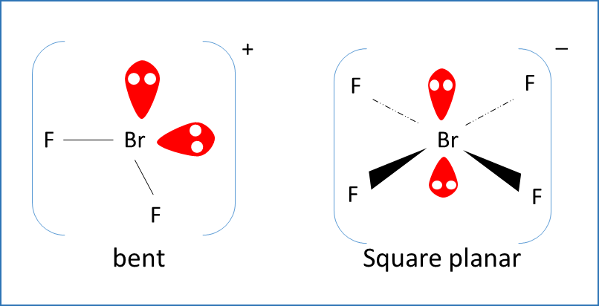
More shapes
The shape of BrF₂⁺ and BrF₄⁻ is given below.
In BrF₂⁺, there are 2 bonding pairs and 2 lone pairs of electrons, forming a tetrahedral shape.
In BrF₄⁻, there are 4 bonding pairs and 2 lone pair of electrons forming a square planar shape.
In square planar shape, the bond angle is 90˚.

Slide 35
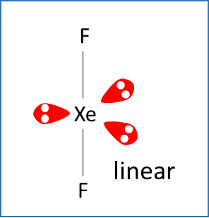
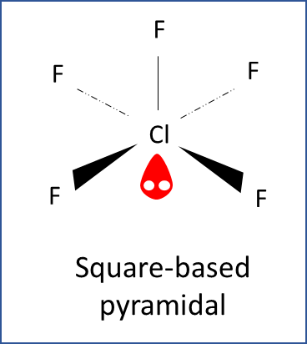
More shapes
The shape of the XeF₂ (3 lone pairs and 2 bonding pairs) is given.
The bonding angle is 180˚
The shape of ClF₅, square-based pyramidal is given.
There are 5 bonding pairs and a lone pair of electrons.

Slide 36
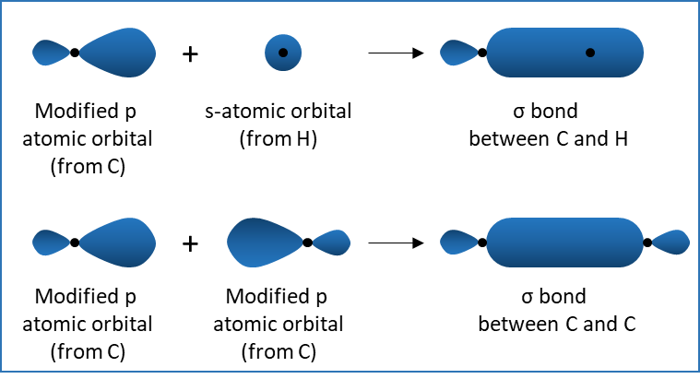
σ bonds
p-orbitals involved in bonding are slightly modified to include some character of the s-orbital.
These modified orbitals overlap linearly to form covalent bonds, which are called as σ bonds.
These bonds are symmetrical and rotate about the bond axis.
This is the strongest type of covalent bonds as the orbitals overlap to a greater extent.
Bonding in organic molecules

Slide 37
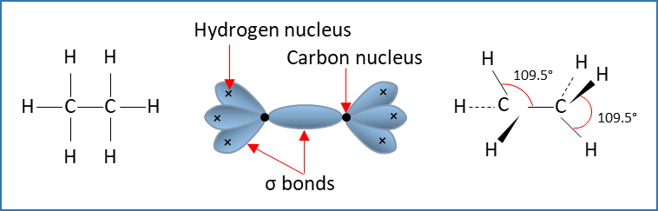
σ bond
Ethane is an alkane with molecular formula C₂H₆.
It consists of a C—C bond and six C—H bonds.
All are σ bonds.
The electron density distribution of ethane molecule is shown in the figure.
As the electron densities are equal, the H-C-H bond angle is 109.5⁰.
A carbon atom and three hydrogen atoms are bonded together to form tetrahedral shape.
Bonding in ethane

Slide 38
Hybridisation
This process of mixing atomic orbitals is called as hybridisation.
One s-orbital and one p-orbital combine to form sp-hybrids.
Each orbital of sp-hybrid has 50% s-character and 50 % p-character.
Similarly, one s-orbital and two p-orbitals combine to form sp² hybrids.
Similarly, one s-orbital and three p-orbitals combine to form sp³ hybrids. In sp³ hybrids, each orbital has ¼ s-character and ¼ p-character.

Slide 39
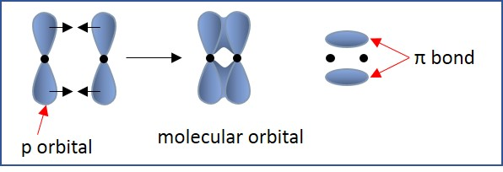
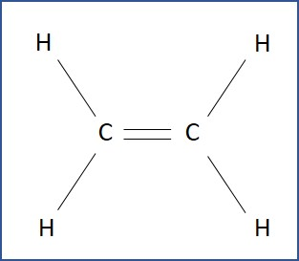
π bond
Modified p-orbitals overlap linearly to form σ-bonds. p-orbitals overlap sideways to form π- bonds.
π - bonds are weaker than σ-bonds due to less overlap of p-orbitals in π-bonds. π - bonds cannot be rotated.
The electron configuration of carbon is 1s² 2s² 2p². It has four valence electrons: two from s-orbital and two from p-orbitals.
Three of these valence electrons are involved in σ-bonds: two bonds with hydrogen and one with another carbon atom.
The fourth electron that occupies a p-orbital, overlaps sideways with the p-orbital of another carbon atom to form a π-bond.
Bonding in alkenes and ethene

Slide 40
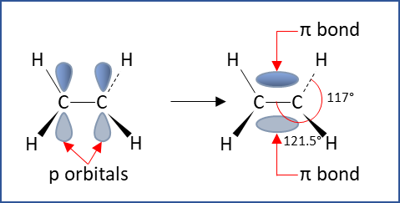
Bonding in alkenes
Ethene is planar in shape to ensure maximum overlapping of p-orbitals in π-bond.
The H—C—H forms a trigonal planar shape with a bond angle of 117⁰.
The bond angle for trigonal planar shapes is 120⁰ and in this case, it is 117⁰. This is because of the position of π-bond that minimises the repulsive forces.
Structure of ethene

Slide 41
Intermolecular forces
The forces between the molecules in covalent bonds are called as intermolecular forces. These forces are weak. There are three types of intermolecular forces:
permanent dipole-dipole forces
Instantaneous dipole forces
hydrogen bonding
The relative bonds strengths of intermolecular forces is:
permanent dipole-dipole forces < instantaneous dipole forces < hydrogen bonding < covalent bonding < ionic bonding

Slide 42
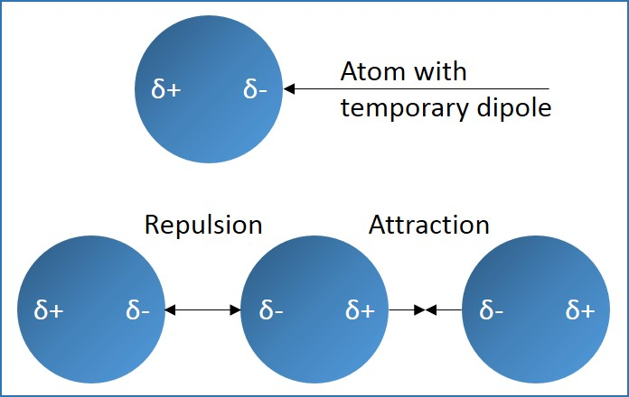
Instantaneous dipole forces
Instantaneous dipole forces are weak forces of attraction that hold the non-polar molecules together.
Due to constant motion of molecules, electron cloud on one side of the molecule is more than the other side.
This gives rise to a dipole. This dipole induces dipole on neighbouring molecules.
The resulting force of attraction between the molecules is called instantaneous dipole-induced dipole force.
This force is also called temporary dipole-induced dipole force or London dispersion force

Slide 43
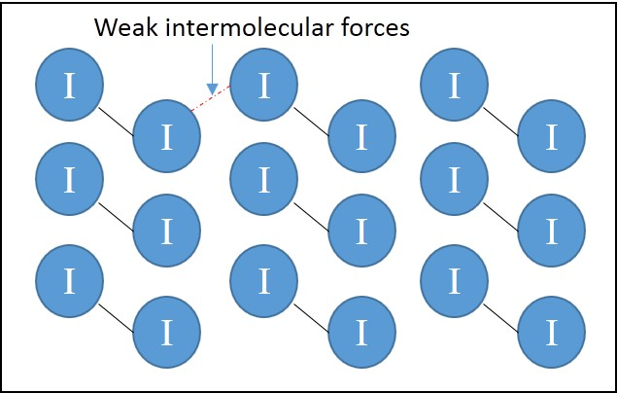
Instantaneous dipole forces
The magnitude of this force depends on the number of electrons within the molecule.
Because, more the number of electrons, larger is the chance of forming an instantaneous dipole and larger will be the dipole.
The magnitude of this force also depends on the shape of the molecule. Because, larger the area of contact, larger will be the force. The greater the instantaneous dipole force, greater will be the boiling point.
The structure of crystals of iodine where the iodine molecules are held by weak instantaneous dipole forces.

Slide 44
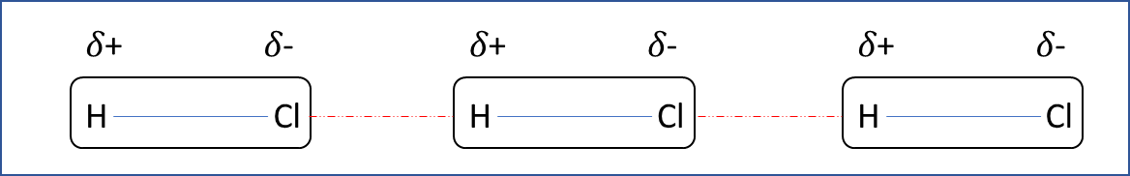
Intermolecular forces: Permanent dipole-dipole forces
The forces of attraction between two molecules having permanent dipoles are called permanent dipole-dipole forces.
This type of forces is found in polar molecules with permanent dipoles.
The δ+ of a molecule is attracted towards δ- of another molecule and a weak attractive force is created.
For example: In HCl, the electronegativity of chlorine is more than that of hydrogen. As a result, chlorine gets slightly negative charge and hydrogen gets a slight positive charge.

Slide 45
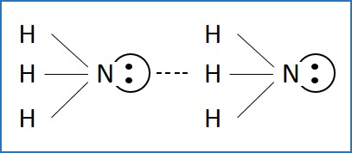
Intermolecular forces: Hydrogen bonding
Hydrogen bonding occurs in between two molecules when one molecule with an hydrogen atom is covalently bonded with fluorine, oxygen or nitrogen (the most electronegative elements) and another molecule having fluorine, oxygen or nitrogen with a lone pair of electrons.
In ammonia, bond is highly polarised due the presence of nitrogen which obtains a δ- charge.
Hydrogen gets a δ+ charge that is high enough to form a bond with the lone pair of electrons in the neighbouring nitrogen atom.

Slide 46
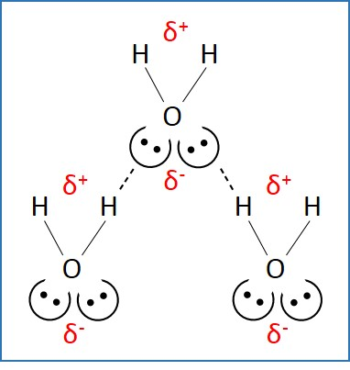
Anomalous properties of H₂O
Water molecule has two hydrogen atoms and two lone pair of electrons per molecule.
It has an average of two hydrogen bonds per molecule.
Ice is less dense than water because of comparatively long hydrogen bonds, the particles in solid state are slightly apart than in liquid state.
Water molecule

Slide 47
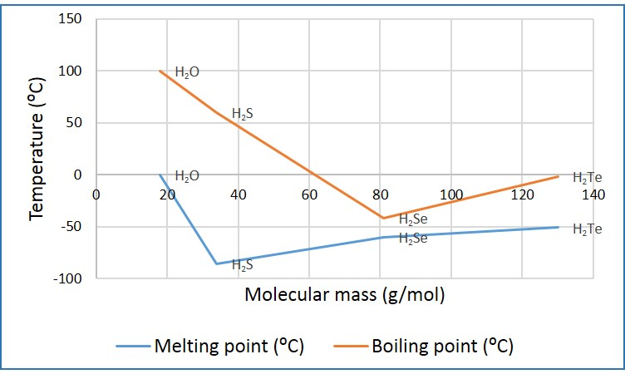
Anomalous properties of H₂O
Due to extensive hydrogen bonding, water has relatively high melting and boiling points compared to the hydrides of other elements of the same group as shown in the graph.
Therefore, the energy required to break bonds in H₂O is greater than hydrides of the same group.
Energy required to break bonds of hydrides of group 16

Slide 48
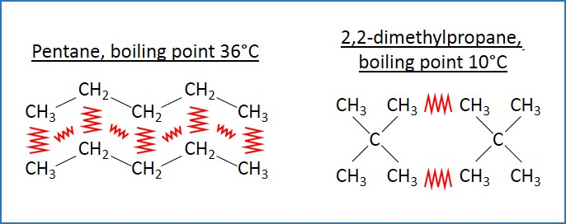
Variation of boiling points in alkanes
The boiling point of alkane homologous series increases due to increase in the number of electrons in bigger molecules. This increase in number of electrons increases the size of induced dipole-dipole interactions (London forces) between the molecules.
The intensity of induced dipole-dipole interactions in a molecule is also dependent on its shape.
Long chain alkanes have larger London force when compared to that of spherical shaped branched alkanes because of the larger contact area between the molecules in long chain alkanes.
As a result, long chain alkanes have higher boiling points when compared to spherical shaped branched alkanes.
Variation of boiling points

Slide 49
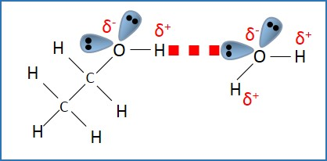
High boiling point of alcohols compared to alkanes
Alcohols are polar molecules due to the presence of hydrogen bonding. Oxygen is a more electronegative element compared to hydrogen.
As a result, oxygen is slightly negative, and a positive charge is induced in hydrogen atom.
The strength of polarity reduces as the length of carbon chain increases.
Due to the presence of hydrogen bonds, alcohols have higher boiling points when compared to alkanes of relative molecular masses.
For example: boiling point of methanol is higher than that of methane.
In other words, alcohols are less volatile (tendency to vaporise) compared to alkanes of relative molecular masses.
Hydrogen bonding in alcohols

Slide 50
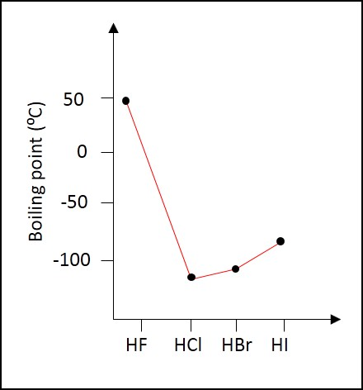
Variation in boiling points of hydrogen halides
The boiling points rises from HCl to HI. This is due to the increase in number of electrons. This results in increase in magnitude of London dispersion forces
The boiling point of HF is very high. This is due to the strong hydrogen bonding between HF molecules.
Boiling points of hydrogen halides

